Slide 1
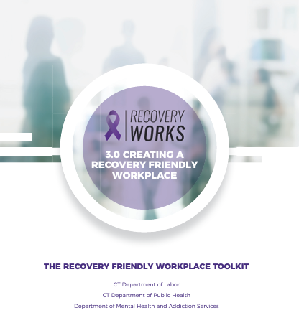


Evaluation of Connecticut’s
Recovery Friendly Workplace (RFW) Toolkit Initiative
funded through the CT Statewide Opioid Response (SOR) grant
A presentation to the
Alcohol and Drug Policy Council Prevention Subcommittee
May 20, 2024
By the DMHAS Center for Prevention Evaluation and Statistics (CPES) at UConn Health

Slide 2
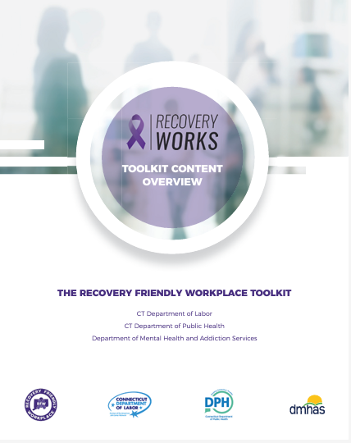
The RFW initiative was launched in 2020 by the Connecticut Department of Labor (DOL) and Connecticut Department of Mental Health and Addiction Services (DMHAS).
The initiative is based on the development and implementation of a toolkit that is utilized by CT-based organizations looking to assess existing organizational practices and expand resources to support substance use disorder (SUD) recovery in their workplaces.
The DMHAS Center for Prevention Evaluation and Statistics (CPES) at UConn Health developed method(s) and tool(s) to evaluate Recovery Friendly Workplace toolkit effectiveness by assessing the barriers, facilitators to implementation and sustainability of RFW toolkit, and making recommendations based on those findings.

Slide 3
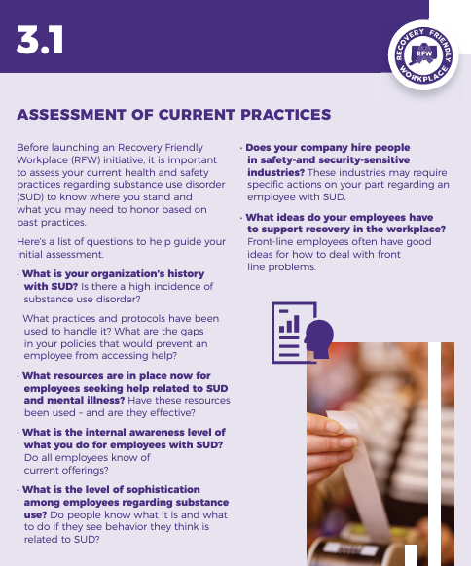




Evaluation Questions
What is the RFW recruitment process employed by project coordinators and/or peer navigators?
What are the barriers and facilitators to RFW engagement?
Why do organizations not engage in the RFW process after recruitment attempts are made?
How are the toolkit and RFW process used and adapted by RFW project coordinators to best fit with regions and/or organizations?
What are policy and practice changes within organizations before and after RFW toolkit implementation and the barriers and facilitators to changes?

Slide 4
Project Coordinator Monthly Meetings
Project Coordinators from all 5 regions met monthly to discuss RFW Toolkit implementation.
A member of the evaluation team attended the monthly meetings and took detailed notes that captured information including:
  Recruitment and Engagement process
  Implementation process
  Barriers and facilitators to RFW implementation
  Adaptations of the toolkit
Notes were qualitatively analyzed to determine main themes

Slide 5
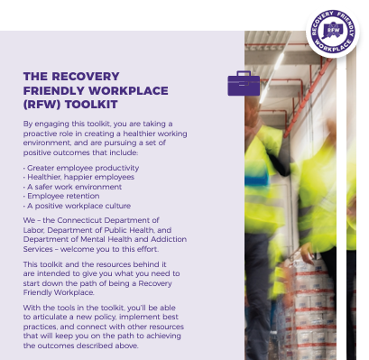
Recruitment Efforts
Built on Existing Relationships
Regions focused on local, personalized outreach to small businesses and non-profit organizations;
Utilized existing partnerships with (e.g., Board Member organizations, union contacts, local chambers and councils);
Networked with sister organizations to those already recruited.
Utilized Marketing Approaches
Flyers;
Mass mailers (Mail Chimp, Constant Contact);
Presentations at job fairs;
Regional Recovery events;
Lunch and Learns.
Pooled Resources
Standard messaging across all regions e.g., billboards, local radio stations, Spotify;
Statewide presentation (10-15 min) shared with local businesses – collaborative effort across regions

Slide 6
Adaptations and Innovations
Tying RFW to Narcan training: involving transportation/bus line drivers into the Narcan trainings and subsequently RFW. They used the possession of first aid kits on buses as analogy to carrying Narcan kits.
Putting RFW under the umbrella of behavioral health/wellness workplace to address the stigma of "recovery friendly.”
Developing user-friendly guide to the toolkit for organizations committed to going through RFW program.

Slide 7
Key Takeaways
What are the barriers and facilitators to RFW engagement?
Facilitators to engagement:
To engage organizations, Project Coordinators:
  shared mutual connections and referred coordinators to organizations in their regions;
  were intentional about how they portrayed RFW to organizations to allay fears of big RFW policy changes, explaining that it is scalable and can be revamped to what it meant to these organizations and what programs they already had in place;
  highlighted the cost saving benefits of RFW to businesses such as preventing absenteeism in the long run.

Slide 8
Recruitment Challenges
Some organizations were reluctant to become RFW because they felt the process was too much work for two few tangible benefits.
Stigma associated with the substance misuse aspect of “recovery friendly” limited the interest in RFW by come organizations, particularly those in the commercial sector. Regions’ initial focus on organizations in the “helping professions” more in tune with substance use as a concern yielded positive results, but stigma of the “recovery friendly” label still needs to be addresses.
Other organizations were concerned about insurance premium increases and legal issues associated with becoming a RFW.
The lack of a statewide campaign to raise awareness of the benefits of being a RFW and substance use in the workplace (reducing stigma) may have facilitated recruitment by addressing these issues.
Limited support for peer navigators in most regions was a barrier, because peer navigators were a key resource for the organizations, bridging the gap between RFW Coordinators and workplaces, and workplaces and workers, as they considered and navigated the RFW process.
Source: Project Coordinator Feedback

Slide 9
Key Takeaways
What are the barriers and facilitators to RFW engagement?
Barriers to engagement: The following reasons were cited for lack of engagement or participation in the RFW process:
  Stigma associated with substance use disorders and concern about the possibility of insurance premiums increasing;
  Workforce challenges (e.g., significant understaffing), as committing to RFW is perceived as additional work that could not be managed with the existing resources;
  RFW policy changes are perceived as time-consuming, especially with the issue of understaffing;
  Procedures and laws (e.g., cannabis legalization) are still poorly understood, especially as it translates to the workplace;
  Lack of perceived financial benefits (e.g., no tax benefits);
  No statewide efforts to back up RFW e.g., education to workplaces about RFW;
  Organizations, especially smaller ones, do not see the immediate needs;
  Organizations found the RFW toolkit too bulky to utilize;
  Lack of peer navigators to help with engagement efforts;
  Lack of funding to cover regionally customized RFW promotional materials.

Slide 10
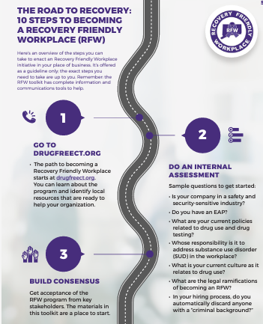
Recruitment Facilitators
Assuring employers that this initiative is an additional tool for EAP;
No policy changes required;
No new team of people or new hires are required to participate;
Participation in the initiative did NOT require them to hire someone in recovery;
Regions with peer navigators utilized them widely, which increased success;
Adaptation of the toolkit to fit organizational contexts e.g., customizing to fit companies' circumstances;
Development of training resources.
Source: Project Coordinator Feedback

Slide 11
Number of Organizations at Each Evaluation Step*
Region | Number of Organizations Completed Pre-assessment | Number of Organizations Completed RFW Certification Checklist | Number of Organizations Completed Post-assessment
1 | 13 | 7 | 10
2 | 4 | 3 | 3
3 | 14 | 15 | 2
4 | 2 | 2 | 1
5 | 1 | 3 | 0
Total | 34 | 30 | 16
*Preliminary data, in process
Sources: Pre-Assessment, Post-Assessment, and Project Coordinator Check-in document

Slide 12

Key Takeaways

Slide 13
Key Takeaways
What is the RFW recruitment process employed by project coordinators and/or peer navigators?
Implementation Processes: Once organizations were recruited, project coordinators and peer navigators engaged businesses and organizations in the RFW process in the following ways:
  Presentations to businesses utilizing a standardized PowerPoint presentation designed by the project coordinators, which each region customized with their logos.
  Training peer champions within recruited organizations.
  Distribution of informational Flyers and Posters to promote RFW.
  Project coordinators and peer navigators tied in RFW messages to things going on at specific times e.g., developed and handed out packages related to Black History Month and Women’s Month.
  Targeting employees and hoping to reach employers i.e., workplace advocacy not tied to Human Resources.
  Collaborated with external organizations who attended some of the project coordinators monthly meetings e.g.,
    Aleksa Bembnista (a person in long term recovery), founder of Glorious Recovery, a non-profit organization that unites, encourages, and empowers people impacted by alcohol and drug, attended the 03/20/2023 meeting as an external speaker to share some perspectives and resources.
    Tom Fulton from CT Clearinghouse attended the 07/24/23 and 08/28/23 meetings to get project coordinators’ input on updating Recovery CT website and developing promotional materials for RFW.
    Kelley Edwards and Denique Weidema-Lewis from DMHAS attended the 09/25/23 meeting to discuss feedback on the initiative.
  Project coordinators started attending bimonthly meetings with DOL 05/25/23.
  Regions planned to honor certified organizations with “recovery breakfasts.”

Slide 14

Facilitators and Barriers of Implementation

Slide 15
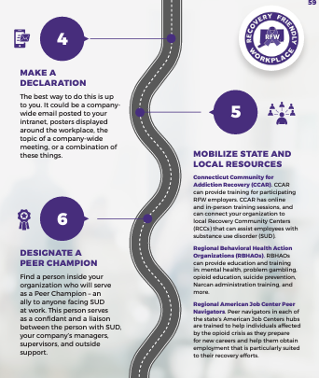
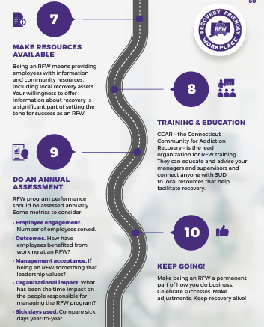

RFW ACCOMPLISHMENTS

Slide 16

Toolkit Adaptations
Project Coordinators adapted RFW toolkit in various forms to better fit the process to their regions and organizations
Regions customized messaging and promotional materials by branding with their logos to fit their communities and organizations.
The evaluation team collected toolkit documentation from project coordinators who made adaptations to the toolkit.
Approaches from different regions were compared to describe the diversity of approaches to fit the resources to participating organizations.

Slide 17
Regional Adaptations: Region 1 (The Hub)
The Hub distilled the RFW toolkit into a summary document:
  4-page summary document contains:
  The internal assessment
  Sample statement of commitment
  Sample companywide email
  Steps to building consensus
  Links to resources for training and education (including full RFW toolkit)
  Post assessment survey
  Sample workplace policy

Slide 18
Regional Toolkit Adaptations: Region 3 (SERAC)
SERAC developed an RFW Employer Orientation packet, which was available to organizations both digitally and physically.
Packet is a 17-page document containing:
  An overview of RFW and some benefits (Save Money, Save Lives)
  RFW testimonials
  Summarized RFW toolkit [8 Steps to be RFW: Internal Assessment/Employee Survey, Build A Consensus/Make A Declaration, Template: Declarations of Intent, Peer Champion/Make Resources Available, Training and Education (Links to resources, including full RFW toolkit), Receiving Certification]
  Sample internal communications/company-wide email
  Poster template
  State official statement.

Slide 19
Regional Adaptations: Region 5
(Western CT Coalition)
Western CT Coalition looped in mental/behavioral health in their messaging on RFW.
Western CT Coalition in conjunction with a behavioral health network, developed a stigma free language guidance document and training videos for employers and employees that can be used as primers for highlighting the prevalence of substance misuse and the benefits of becoming Recovery Friendly.
  Training videos included resources for staff:
    3 min. video on impacts of language
    20 min. training on the biological development of a substance use disorder.
    Library of assorted speakers with personal experiences of substance use disorders
  Training videos included resources for employers:
    1 hr. training with call to action for RFW and steps to take.
    42 min. training to understand COVID's impact on mental health in the workplace and what resources and tools are available to implement in the workplace.
    1 hr. training to learn how to use the cost calculator and the prevalence of employee substance misuse in the workplace.
    46 min. training to learn about how trauma-informed care principles can be infused into the supervision work to re-energize employers and increase staff satisfaction and engagement.

Slide 20
Key Takeaways
What are policy and practice changes within organizations before and after RFW toolkit implementation and the barriers and facilitators to changes?
Following toolkit utilization, organizations foresee the following positive changes:
  Organizing their businesses better to provide opportunities for staff members with lived experiences.
  Becoming more sensitive to the staff needs related to substance use disorders/Mental Health and incorporating recovery balance strategies into future team meetings.
  Informing future employees that they are RFW and following all federal law about protected classes and information. They will not seek recovery information from applicants, any self-disclosure is determined by the applicant.
  Employers now having the opportunity to speak about their recovery friendly status during the hiring process.
  Being RFW is an advantage as potential employees will want to work for them.
One organization stated that they do not hire people with SUD because they are a brewery.
Other organizations did not anticipate any changes in their hiring process, as they were already non-discriminatory towards SUD in the process and already had recovery friendly policies in place.

Slide 21
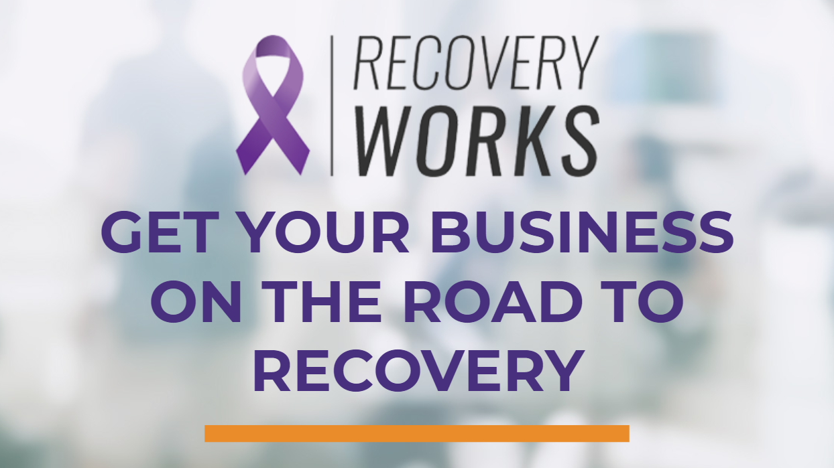

Thank you!
Jennifer Sussman
Coordinator, DMHAS Center for Prevention Evaluation and Statistics (CPES) at UConn Health

